Slide 1
Decision Tree

Slide 2
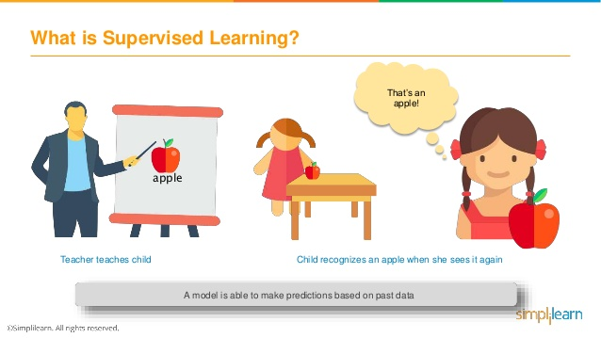
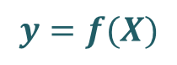
Supervised Learning - Classification
Supervised learning is where you have input variables (X) and an output variable (y) and you use an algorithm to learn the mapping function from the input to the output
The goal is to approximate the mapping function so well that when you have new input data (X) that you can predict the output variables (y) for that data
It is called supervised learning because the process of an algorithm learning from the training dataset can be thought of as a teacher supervising the learning process
$$y=f(X)$$

Slide 3
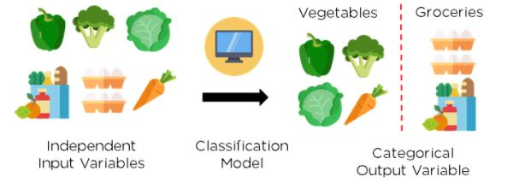
Supervised Learning - Classification
A classification problem is when the output variable is a category, such as
“red” or “blue” or
“disease” and “no disease”

Slide 4

Supervised Learning - Classification

Slide 5
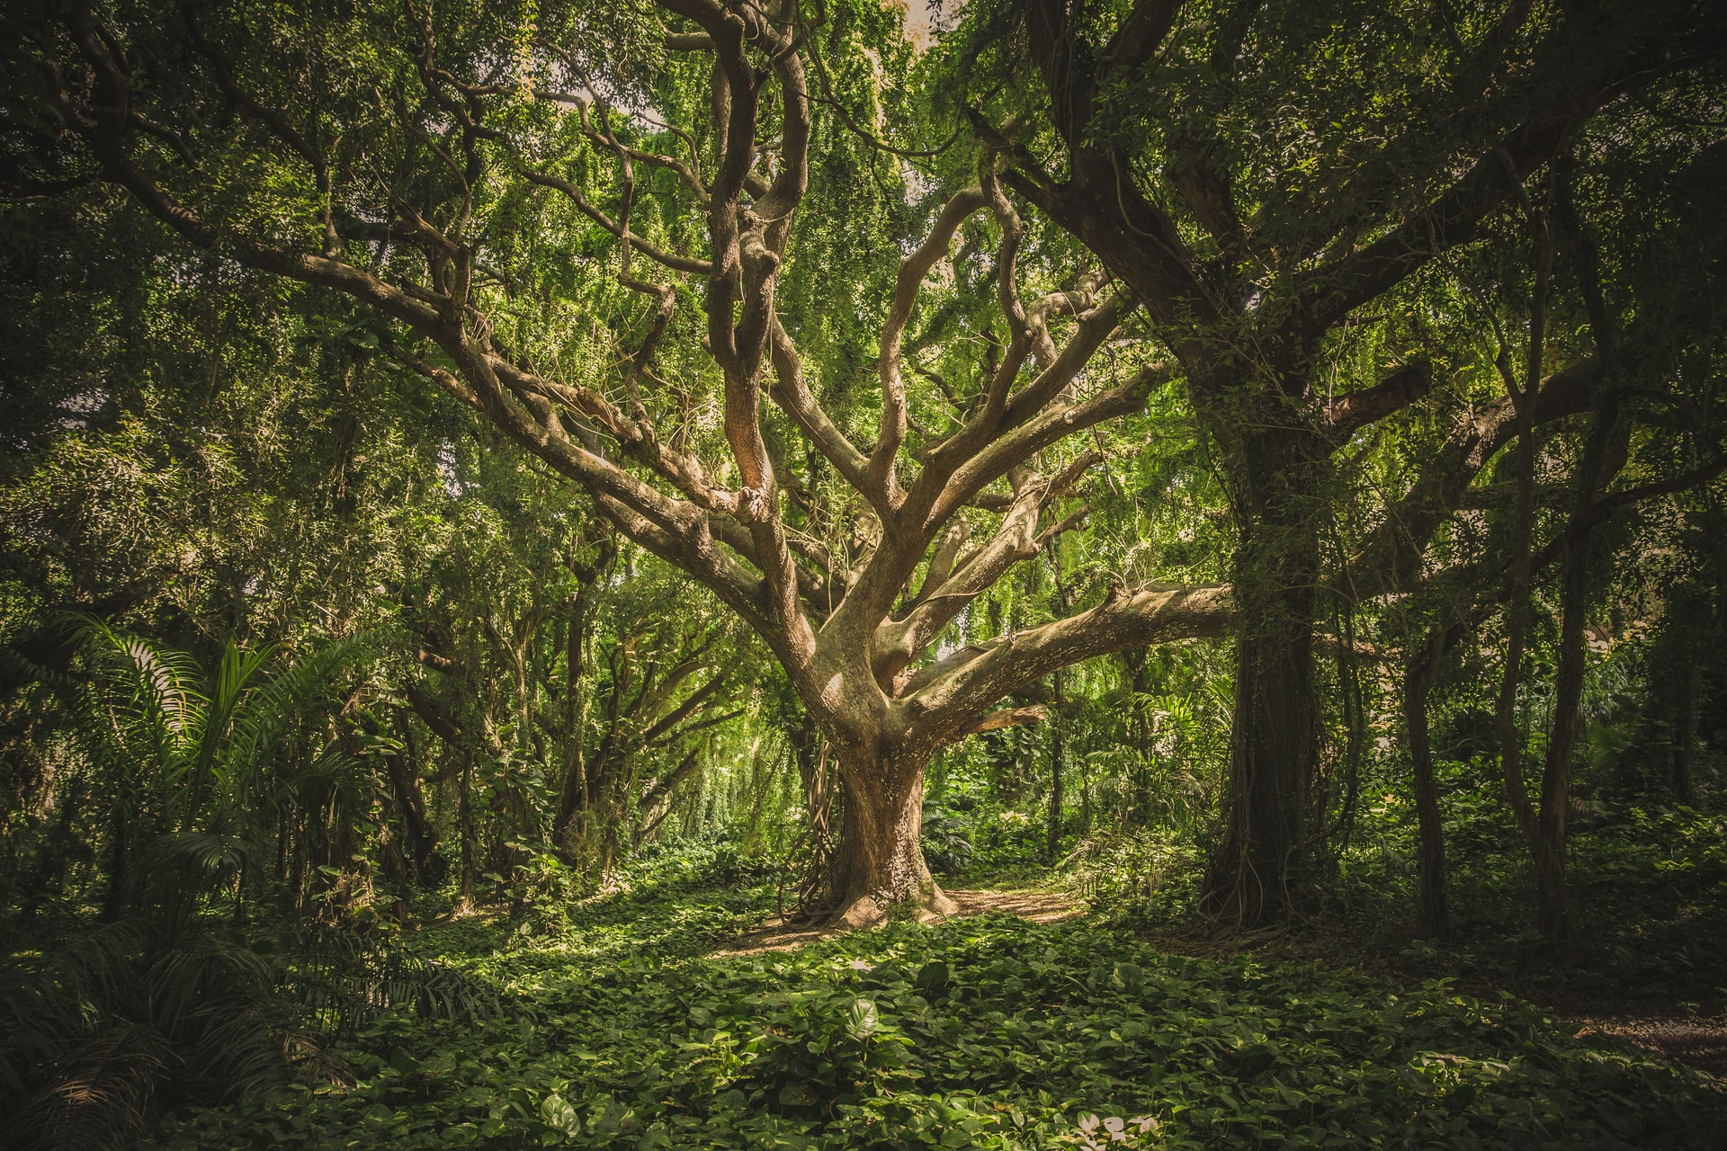
Decision Tree Classifier

Slide 6
What is Decision Tree?
Decision Tree is a Supervised learning technique that can be used for both classification and Regression problems, but mostly it is preferred for solving Classification problems
It is a tree-structured classifier, where
internal nodes represent the features of a dataset
branches represent the decision rules
each leaf node represents the outcome

Slide 7

What is Decision Tree?

Slide 8
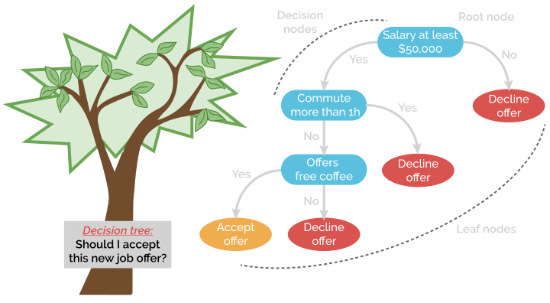
What is Decision Tree?
it starts with the root node, which expands on further branches and constructs a tree-like structure

Slide 9
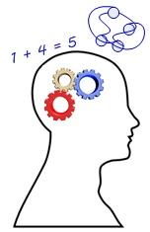
Why use Decision Trees?
Decision Trees usually mimic human thinking ability while making a decision, so it is easy to understand

Slide 10

Why use Decision Trees?
The logic behind the decision tree can be easily understood because it shows a tree-like structure

Slide 11
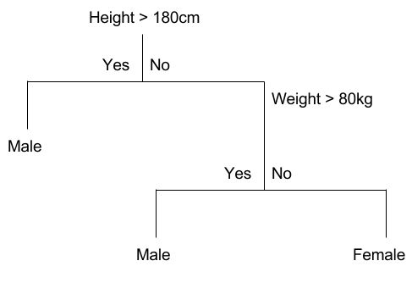
Two Main Types of Decision Trees
Classification Trees
Here the decision variable is Categorical/ discrete
Binary recursive partitioning – a process of splitting the data into partitions, and then splitting it up further on each of the branches.

Slide 12
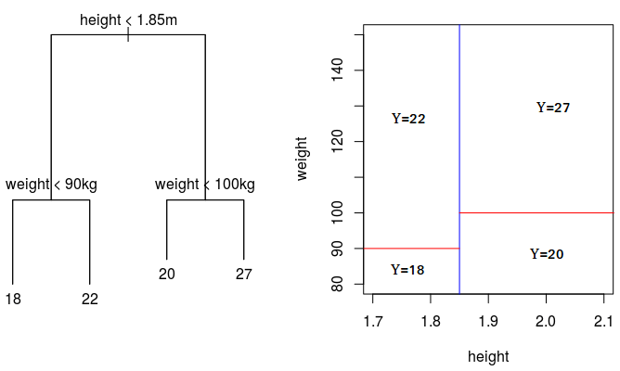
Two Main Types of Decision Trees
Regression Trees
Decision trees where the target variable can take continuous values are called regression trees

Slide 13
Steps in Decision Tree Construction
Begin the tree with the root node, says S, which contains the complete dataset
Find the best attribute in the dataset using Attribute Selection Measure (ASM)
Divide the S into subsets that contain possible values for the best attributes
Generate the decision tree node, which contains the best attribute
Recursively make new decision trees using the subsets of the dataset created in step 3

Slide 14
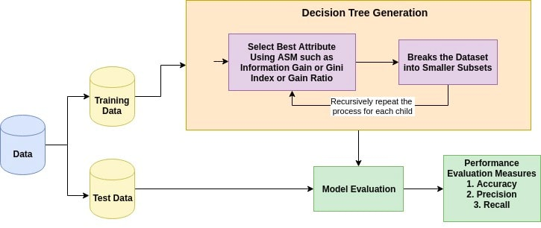
How does Decision Tree Classification Work?

Slide 15
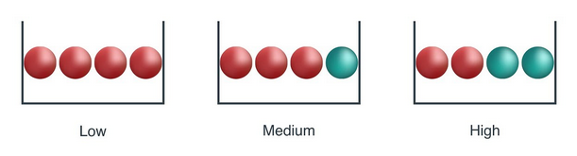
Attribute Selection/Impurity Measures
Let’s understand Impurity with the following toy example
From above image, a ball is randomly drawn from each bowl
How much information you needed to accurately tells the color of ball

Slide 16
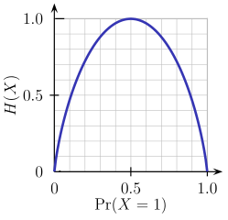
Attribute Selection/Impurity Measures
Entropy
Entropy is the amount of information that is needed to accurately describe a sample
It is a measure of the randomness in the information being processed
The higher the entropy, the harder it is to draw any conclusions from that information
A branch with an entropy of zero is a leaf node and A branch with entropy more than zero needs further splitting

Slide 17
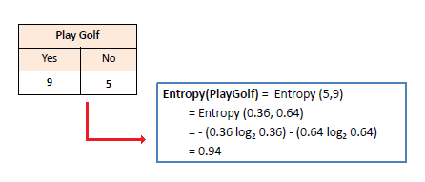
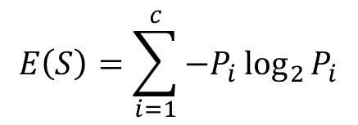
Entropy
Mathematically Entropy for 1 attribute is represented as:
$$E\left(S\right)=\sum_{i=1}^{c}{−P_{i}\log_{2}{P_{i}}}$$

Slide 18
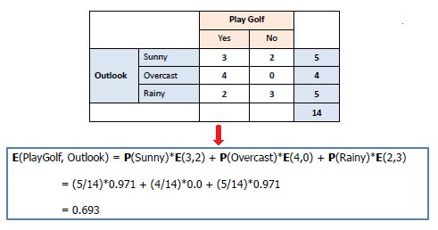
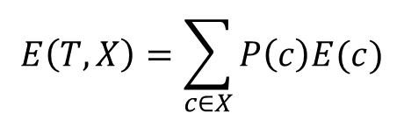
Entropy
Mathematically Entropy for multiple attributes is represented as:
$$E\left(T,X\right)=\sum_{c∈X}{P\left(c\right)E(c)}$$

Slide 19
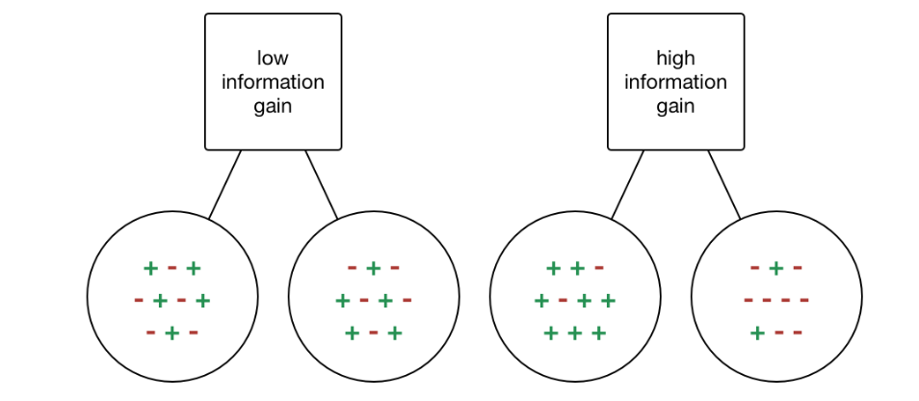
Attribute Selection/Impurity Measures
Information Gain
Information gain or IG is a statistical property that measures how well a given attribute separates the training examples according to their target classification
Constructing a decision tree is all about finding an attribute that returns the highest information gain and the smallest entropy

Slide 20
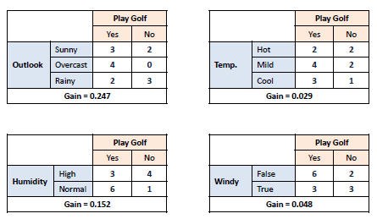
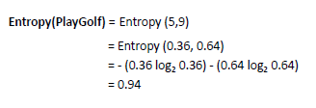
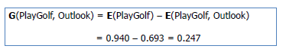
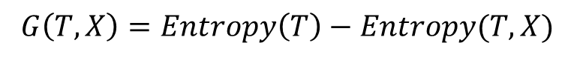
Information Gain
It computes the difference between entropy before split and average entropy after split of the dataset based on given attribute values
$$G\left(T,X\right)=Entropy\left(T\right)−Entropy(T, X)$$

Slide 21
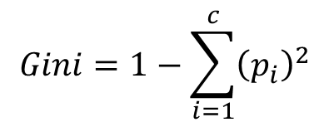
How does Logistic Regression Work?
Gini Index
The Gini index is a cost function used to evaluate splits in the dataset
It is calculated by subtracting the sum of the squared probabilities of each class from one
It favors larger partitions and easy to implement whereas information gain favors smaller partitions with distinct values
$$Gini=1−\sum_{i=1}^{c}{{\left(p_{i}\right)}^{2}}$$

Slide 22
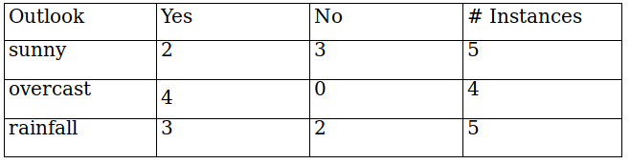
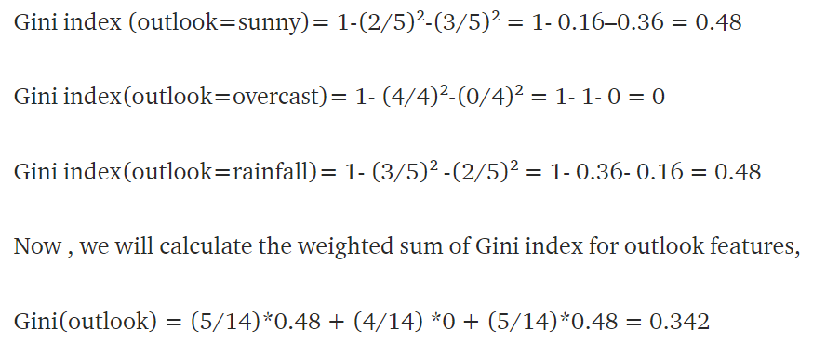
Gini Index

Slide 23
Example with Entropy and Information Gain

Slide 24
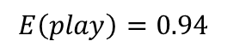
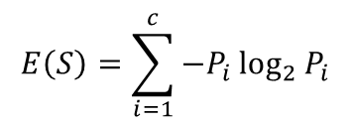
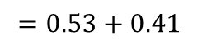
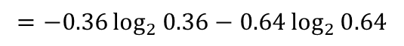
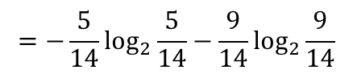
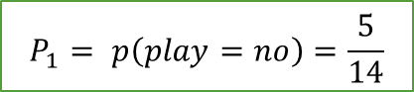
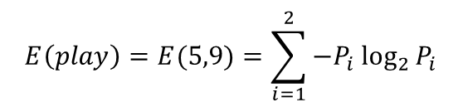

Example with Entropy and Information Gain
$$E\left(S\right)=\sum_{i=1}^{c}{−P_{i}\log_{2}{P_{i}}}$$
$$P_{1}= p\left(play=no\right)=\frac{5}{14}$$
$$E\left(play\right)=E(5,9)=\sum_{i=1}^{2}{−P_{i}\log_{2}{P_{i}}}$$
$$P_{2}= p\left(play=yes\right)=\frac{9}{14}$$
$$=−\frac{5}{14}\log_{2}{\frac{5}{14}−\frac{9}{14}\log_{2}{\frac{9}{14}}}$$
$$=−0.36\log_{2}{0.36−0.64\log_{2}{0.64}}$$
$$=0.53+0.41$$
$$E\left(play\right)=0.94$$

Slide 25
How does Logistic Regression Work?
Now, we have four features to make decision and they are:
Outlook
Temperature
Windy
Humidity

Slide 26
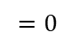
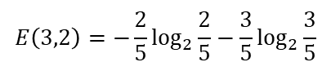
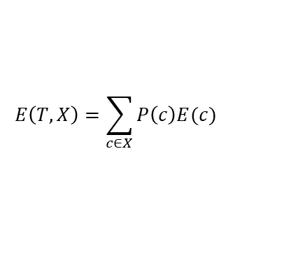
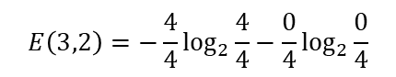
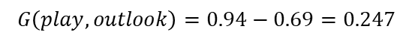
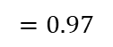
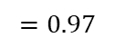
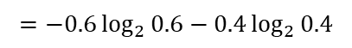
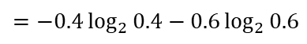
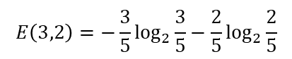
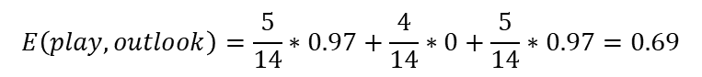
Example with Entropy and Information Gain
If we make a decision tree division at this level 0 based on outlook, we have three branches possible; either it will be Sunny or Overcast or it will be Raining
$$E\left(T,X\right)=\sum_{c∈X}{P\left(c\right)E(c)}$$
$$E\left(play,outlook\right)=P\left(sunny\right)E\left(3,2\right)+P\left(ovecast\right)E\left(4,0\right)+P\left(rainy\right)E(2,3)$$
$$E\left(3,2\right)=−\frac{3}{5}\log_{2}{\frac{3}{5}−\frac{2}{5}\log_{2}{\frac{2}{5}}}$$
$$E\left(3,2\right)=−\frac{2}{5}\log_{2}{\frac{2}{5}−\frac{3}{5}\log_{2}{\frac{3}{5}}}$$
$$E\left(3,2\right)=−\frac{4}{4}\log_{2}{\frac{4}{4}−\frac{0}{4}\log_{2}{\frac{0}{4}}}$$
$$=−0.6\log_{2}{0.6−0.4\log_{2}{0.4}}$$
$$=−0.4\log_{2}{0.4−0.6\log_{2}{0.6}}$$
$$=0$$
$$=0.97$$
$$=0.97$$
$$E\left(play,outlook\right)=\frac{5}{14}∗0.97+\frac{4}{14}∗0+\frac{5}{14}∗0.97=0.69$$
$$Information Gain= G\left(play,outlook\right)=Entropy\left(play\right)−Entropy(play,outlook)$$
$$G\left(play,outlook\right)=0.94−0.69=0.247$$

Slide 27
Calculate the information gain for Temperature, Humidity and Windy by yourself….!

Slide 28
Example with Entropy and Information Gain
And hence, the first decision maker is Outlook

Slide 29
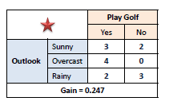
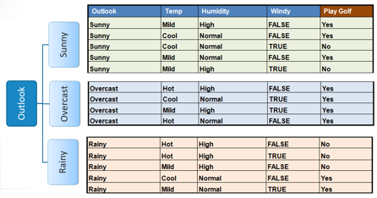
Example with Entropy and Information Gain

Slide 30
Example with Entropy and Information Gain
outlook
sunny
overcast
rainy
Yes

Slide 31
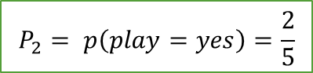
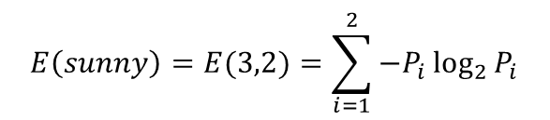
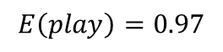
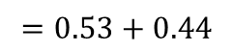
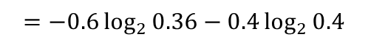
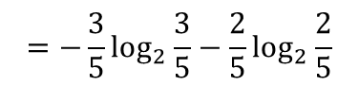

Example with Entropy and Information Gain
Day | outlook | temperature | humidity | windy | play
1 | sunny | hot | high | Weak | No
2 | sunny | hot | high | Strong | No
8 | sunny | mild | high | Weak | No
9 | sunny | cool | normal | Weak | Yes
11 | sunny | mild | normal | Strong | Yes
$$E\left(sunny\right)=E(3,2)=\sum_{i=1}^{2}{−P_{i}\log_{2}{P_{i}}}$$
$$P_{1}= p\left(play=no\right)=\frac{3}{5}$$
$$=−\frac{3}{5}\log_{2}{\frac{3}{5}−\frac{2}{5}\log_{2}{\frac{2}{5}}}$$
$$P_{2}= p\left(play=yes\right)=\frac{2}{5}$$
$$=−0.6\log_{2}{0.36−0.4\log_{2}{0.4}}$$
$$=0.53+0.44$$
$$E\left(play\right)=0.97$$

Slide 32
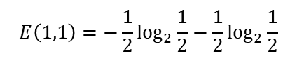







Example with Entropy and Information Gain
$$E\left(T,X\right)=\sum_{c∈X}{P\left(c\right)E(c)}$$
$$E\left(sunny,temperature\right)=P\left(hot\right)E\left(0,2\right)+P\left(mild\right)E\left(1,1\right)+P\left(cool\right)E(1,0)$$
$$E\left(0,2\right)=−\frac{0}{2}\log_{2}{\frac{0}{2}−\frac{2}{2}\log_{2}{\frac{2}{2}}}$$
$$E\left(3,2\right)=−\frac{1}{1}\log_{2}{\frac{1}{1}−\frac{0}{1}\log_{2}{\frac{0}{1}}}$$
$$E\left(1,1\right)=−\frac{1}{2}\log_{2}{\frac{1}{2}−\frac{1}{2}\log_{2}{\frac{1}{2}}}$$
$$=0$$
$$=1$$
$$=0$$
$$E\left(sunny,temperature\right)=\frac{2}{5}∗0+\frac{2}{5}∗1+\frac{1}{5}∗0=0.4$$
$$Information Gain= G\left(sunny,temperature\right)=Entropy\left(sunny\right)−Entropy(sunny,temperature)$$
$$G\left(play,outlook\right)=0.97−0.4=0.57$$

Slide 33
Example with Entropy and Information Gain
G(sunny, temperature) = 0.57
G(sunny, humidity) = 0.97
G(sunny, windy) = 0.02

Slide 34
Example with Entropy and Information Gain
outlook
sunny
overcast
rainy
humidity
Yes
high
normal
No
Yes

Slide 35



Example with Entropy and Information Gain
Day | outlook | temperature | humidity | windy | play
4 | rainy | mild | high | Weak | Yes
5 | rainy | cool | normal | Weak | Yes
6 | rainy | cool | normal | Strong | No
10 | rainy | mild | normal | Weak | Yes
14 | rainy | mild | high | Strong | No
$$E\left(rainy\right)=E(3,2)=\sum_{i=1}^{2}{−P_{i}\log_{2}{P_{i}}}$$
$$P_{1}= p\left(play=yes\right)=\frac{3}{5}$$
$$=−\frac{3}{5}\log_{2}{\frac{3}{5}−\frac{2}{5}\log_{2}{\frac{2}{5}}}$$
$$P_{2}= p\left(play=no\right)=\frac{2}{5}$$
$$=−0.6\log_{2}{0.36−0.4\log_{2}{0.4}}$$
$$=0.53+0.44$$
$$E\left(play\right)=0.97$$

Slide 36








Example with Entropy and Information Gain
$$E\left(T,X\right)=\sum_{c∈X}{P\left(c\right)E(c)}$$
$$E\left(rainy,temperature\right)=P\left(mild\right)E\left(2,1\right)+P\left(cool\right)E\left(1,1\right)$$
$$E\left(2,1\right)=−\frac{2}{3}\log_{2}{\frac{2}{3}−\frac{1}{3}\log_{2}{\frac{1}{3}}}$$
$$E\left(3,2\right)=−\frac{1}{2}\log_{2}{\frac{1}{2}−\frac{1}{2}\log_{2}{\frac{1}{2}}}$$
$$=−0.67\log_{2}{0.67−0.33\log_{2}{0.33}}$$
$$=−0.5\log_{2}{0.5−0.5\log_{2}{0.5}}$$
$$=0.91$$
$$=1$$
$$E\left(rainy,temperature\right)=\frac{3}{5}∗0.91+\frac{2}{5}∗1=0.95$$
$$Information Gain= G\left(rainy,temperature\right)=Entropy\left(rainy\right)−Entropy(rainy,temperature)$$
$$G\left(rainy,temperature\right)=0.97−0.95=0.02$$

Slide 37
Example with Entropy and Information Gain
G(rainy, temperature) = 0.02
G(rainy, humidity) = 0.02
G(rainy, windy) = 0.97

Slide 38
Example with Entropy and Information Gain
outlook
sunny
overcast
rainy
humidity
Yes
windy
high
normal
weak
strong
No
Yes
Yes
No

